Slide 1
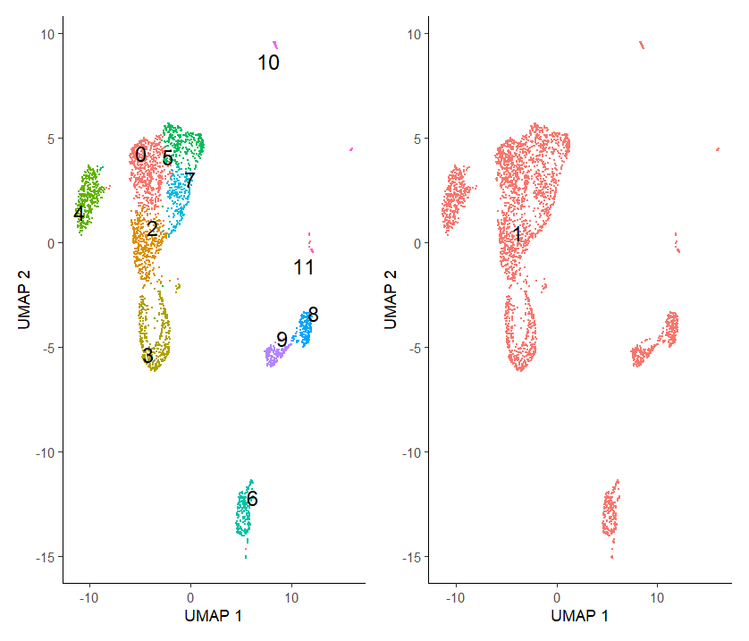
Initial clusters
Cluster 3 has highest Mki67 expression
Cluster 4 is Tregs

Slide 2
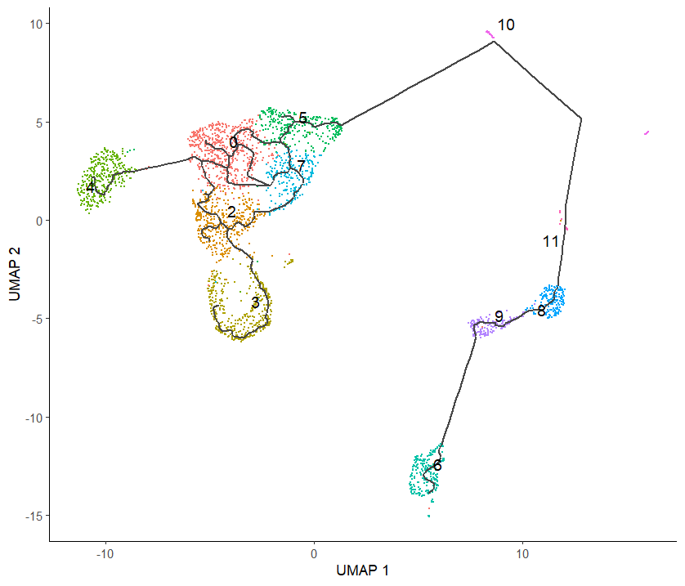
Trajectory with cluster 3 as start cluster

Slide 3
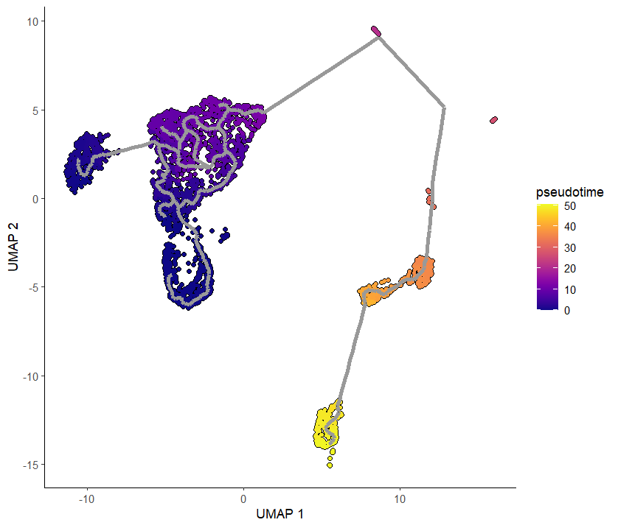
Pseudotime trajectory

Slide 4
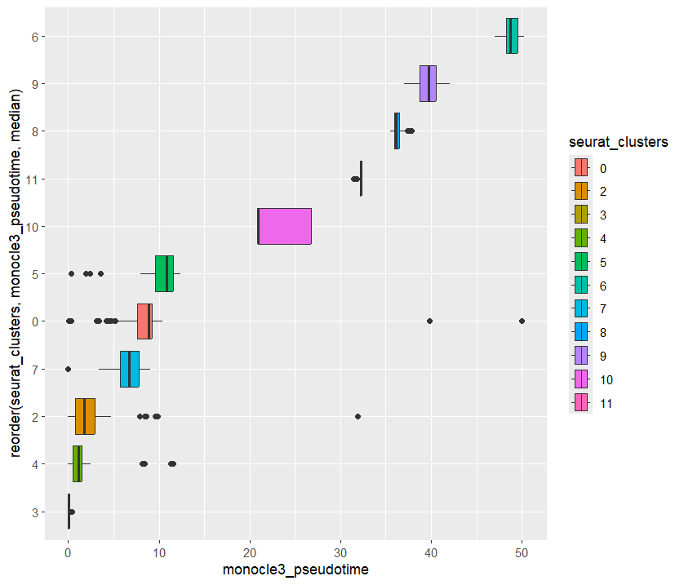
Ordering the clusters by their pseudotime

Slide 5
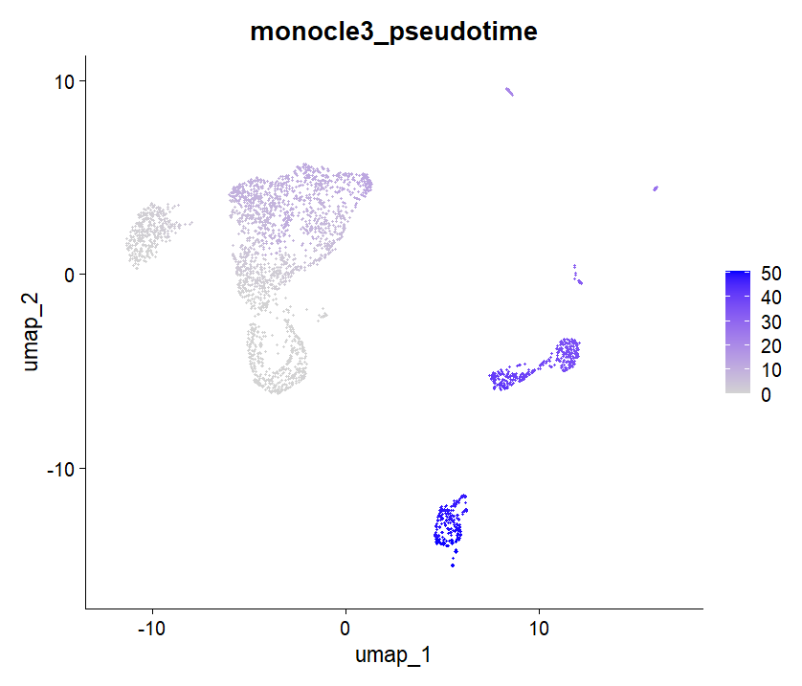
Pseudotime Feature Plot

Slide 6
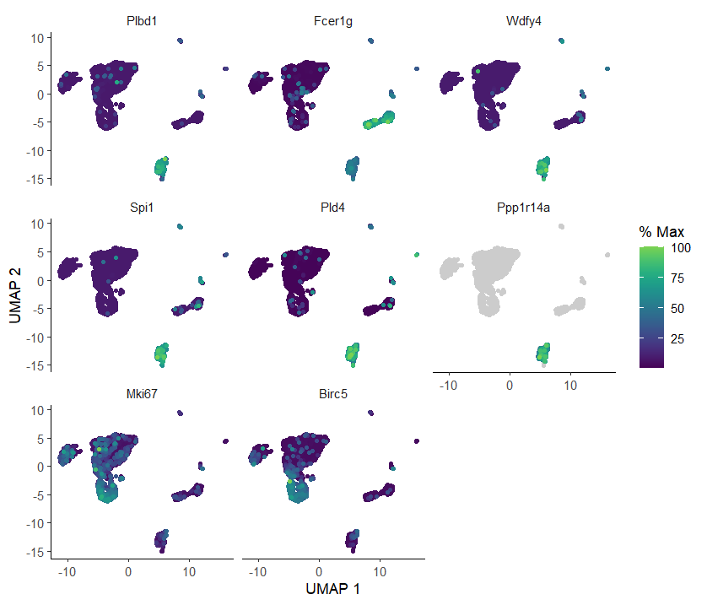
Differentially Expressed Genes based on pseudotime

Slide 7
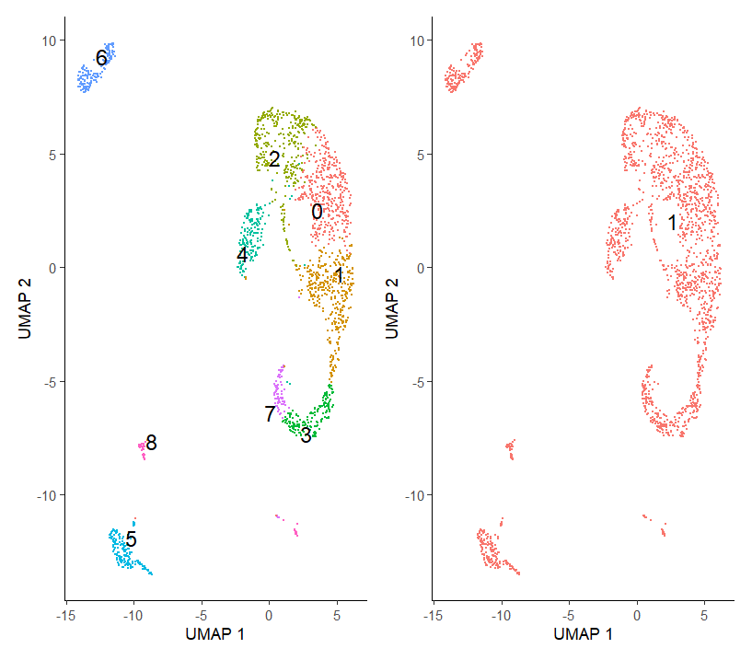
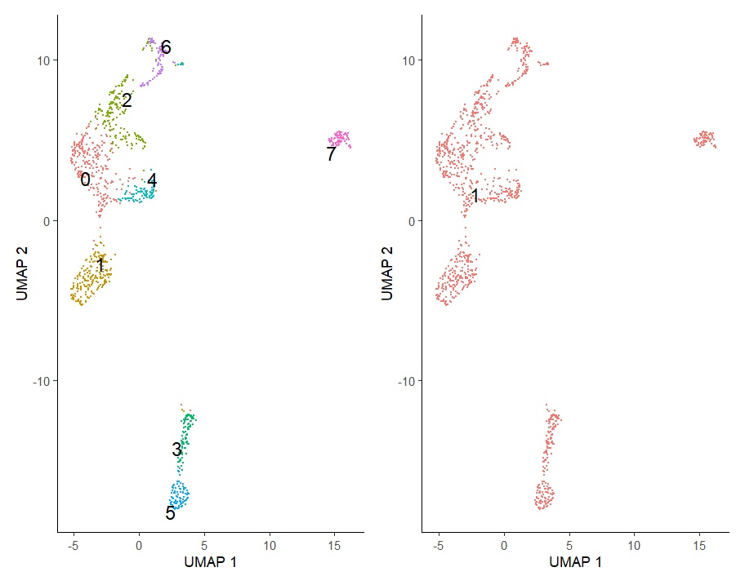
Split by treatment
PBS
CUE
Cluster 3 has highest Mki67 expression
Cluster 4 is Tregs
Cluster 6 has highest Mki67 expression
Cluster 1,6 is Tregs

Slide 8
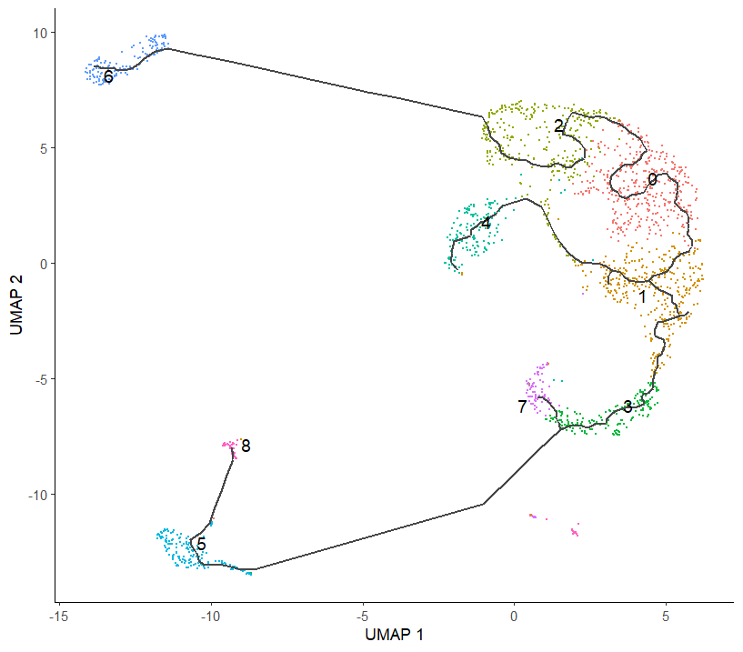
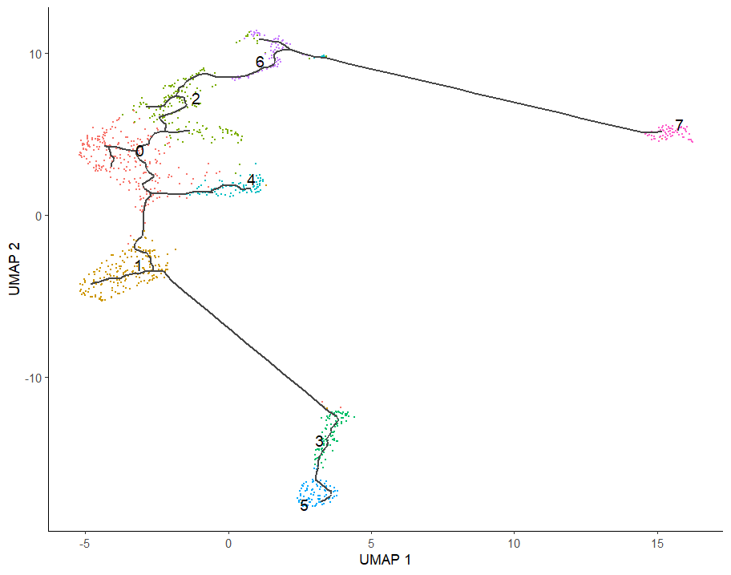
Split by treatment
PBS
CUE
Cluster 3 has highest Mki67 expression
Cluster 4 is Tregs
Cluster 6 has highest Mki67 expression
Cluster 1,6 is Tregs
Treg
Treg
Treg

Slide 9
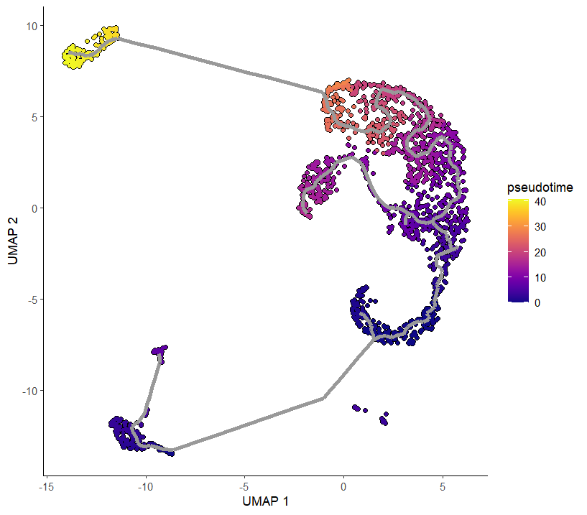
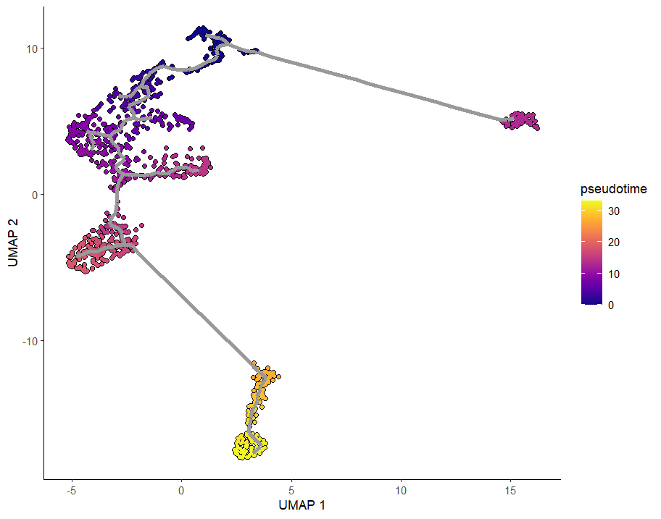
Split by treatment
PBS
CUE
Cluster 3 has highest Mki67 expression
Cluster 4 is Tregs
Cluster 6 has highest Mki67 expression
Cluster 1,6 is Tregs
Treg
Treg
Treg

Slide 10
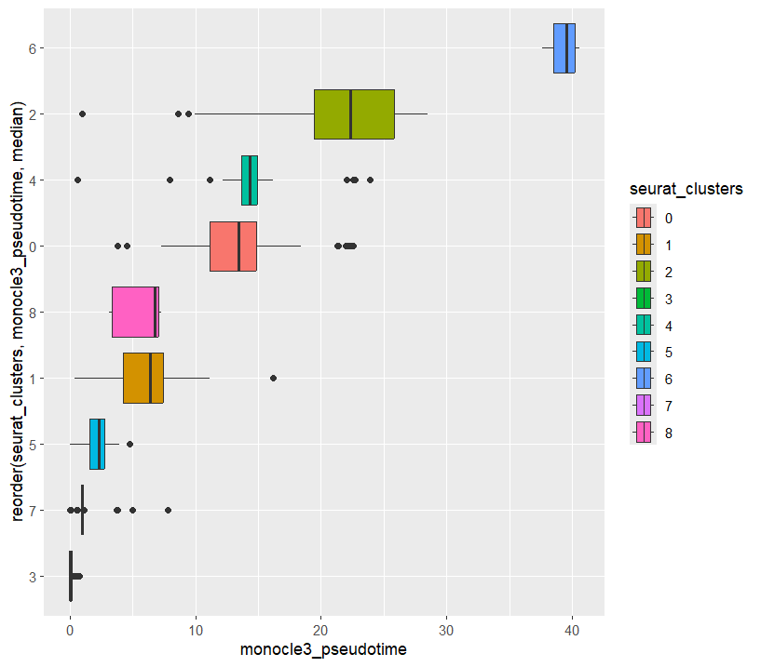
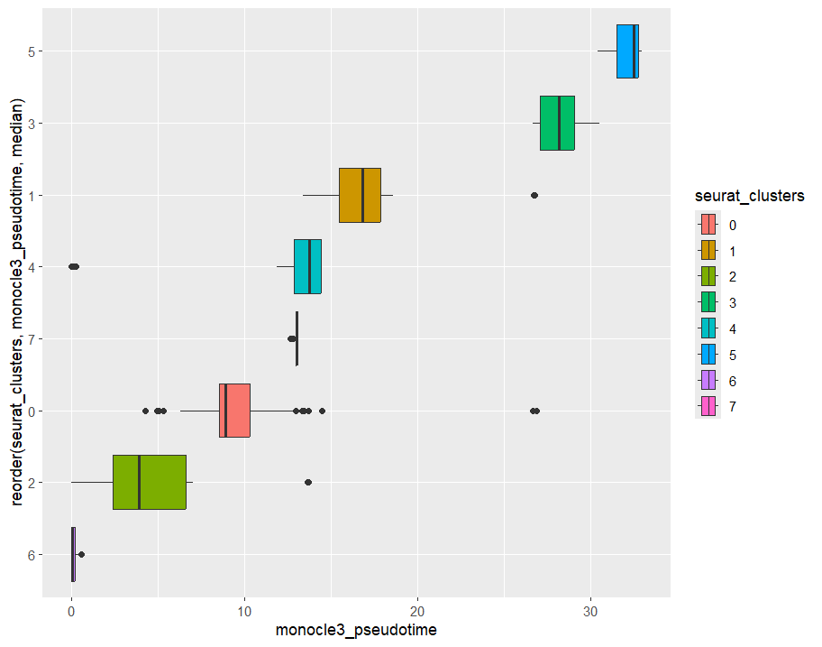
Split by treatment
PBS
CUE
Cluster 3 has highest Mki67 expression
Cluster 4 is Tregs
Cluster 6 has highest Mki67 expression
Cluster 1,6 is Tregs
Treg
Treg
Treg

Slide 11
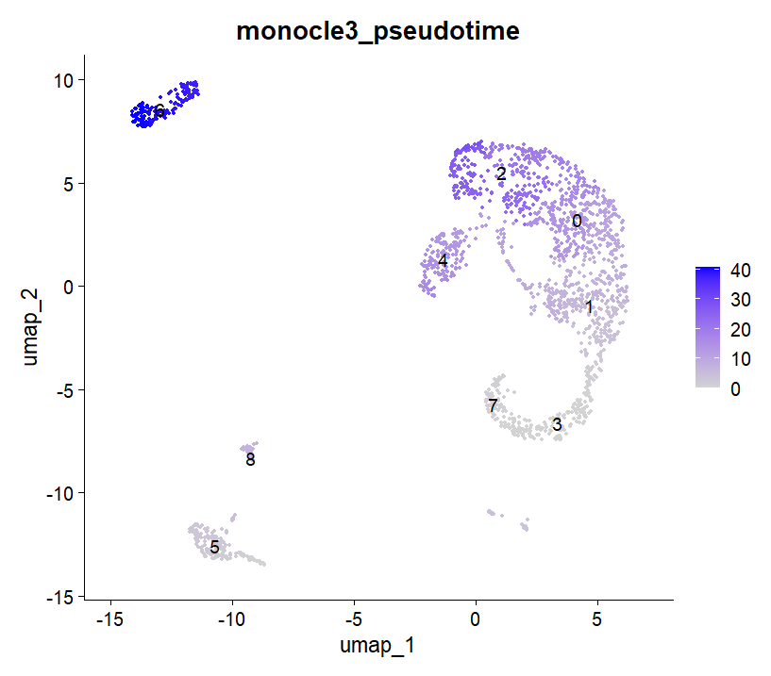
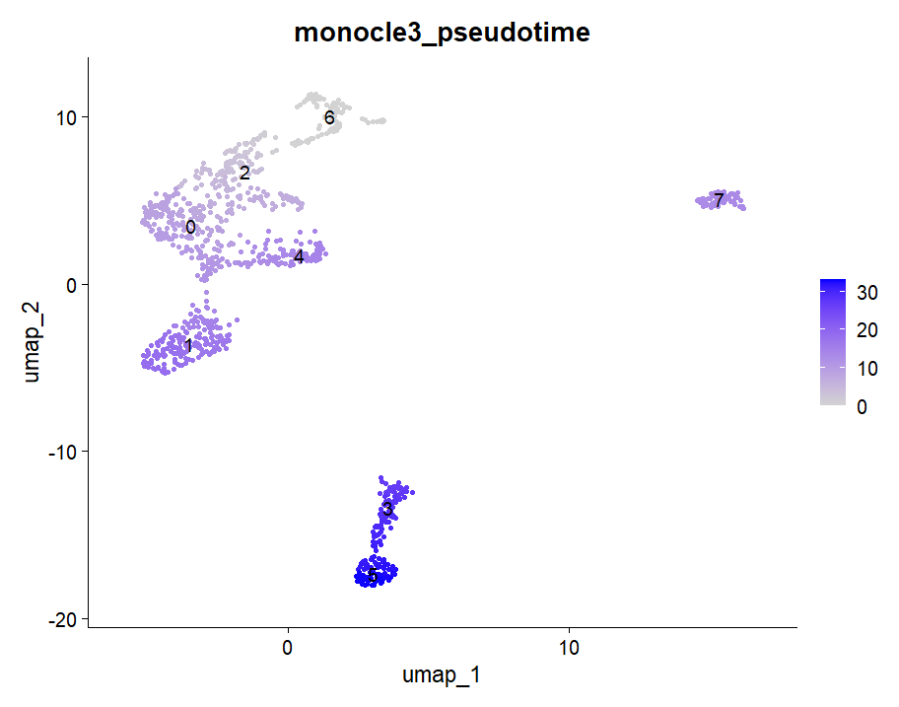
Split by treatment
PBS
CUE
Cluster 3 has highest Mki67 expression
Cluster 4 is Tregs
Cluster 6 has highest Mki67 expression
Cluster 1,6 is Tregs
Treg
Treg
Treg

Slide 12
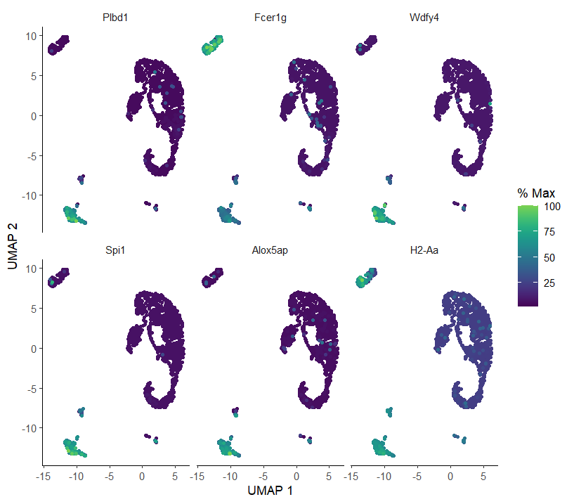
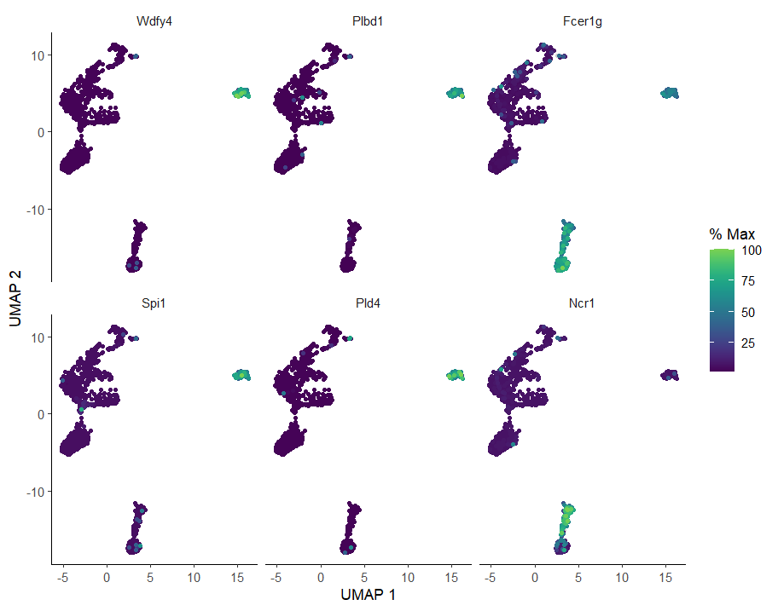
Split by treatment
PBS
CUE
Cluster 3 has highest Mki67 expression
Cluster 4 is Tregs
Cluster 6 has highest Mki67 expression
Cluster 1,6 is Tregs

Slide 13
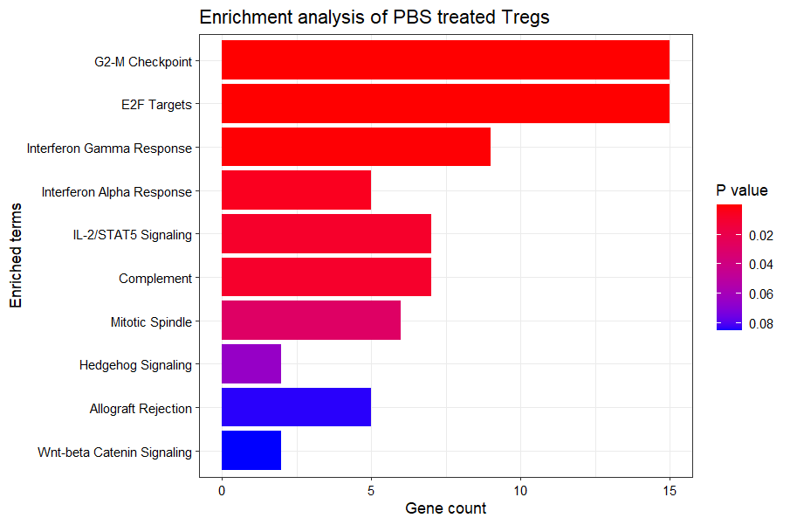
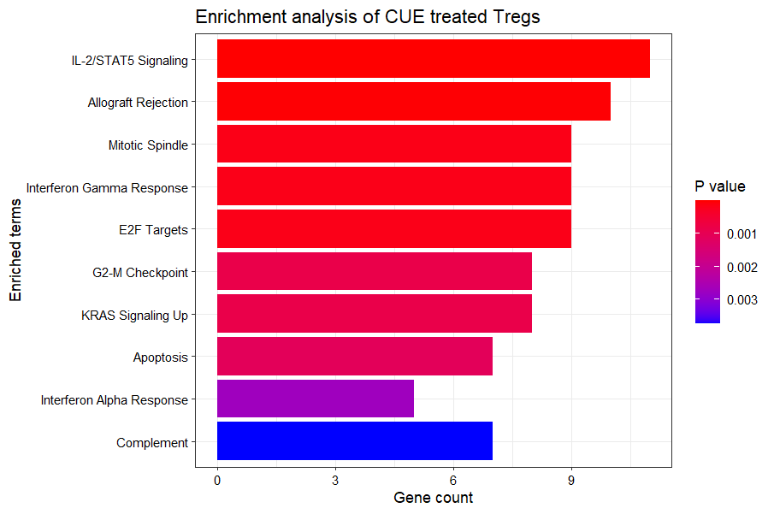
Functional Enrichment Analysis
Cluster 4 in the Cd4 subset was identified as the Treg cluster
Genes expressed in IL2/STAT5 Pathway:
Ifitm3, Cd86, Ecm1, Ccne1, Il1r2, Swap70, Ctsz, Penk, Tnfrsf8, Eno3, Hk2

Slide 14
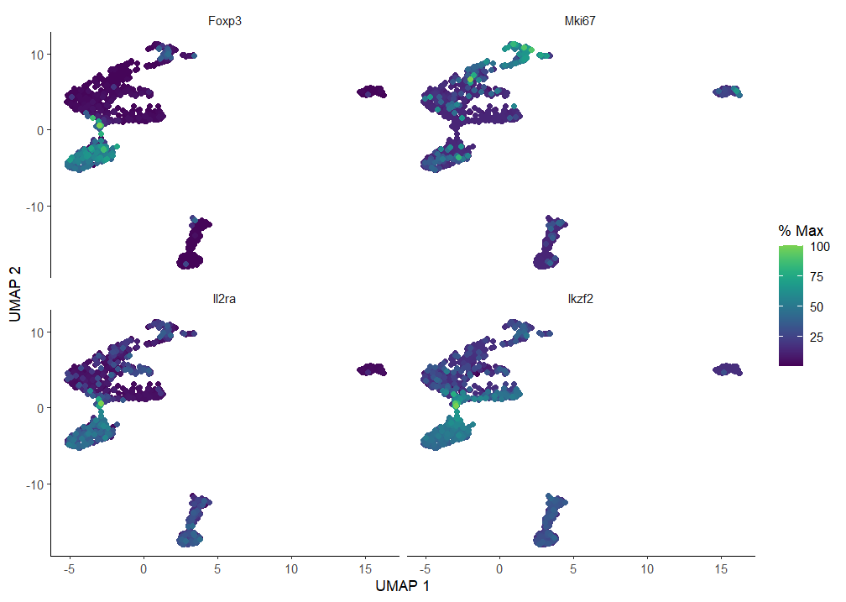
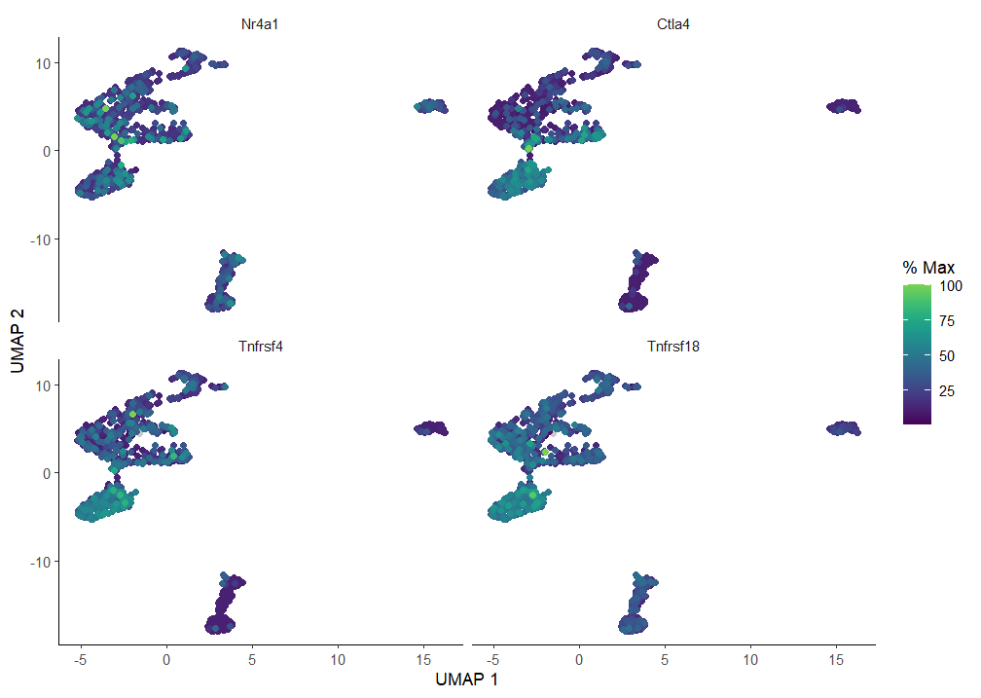
Gene expression in CUE

Slide 15
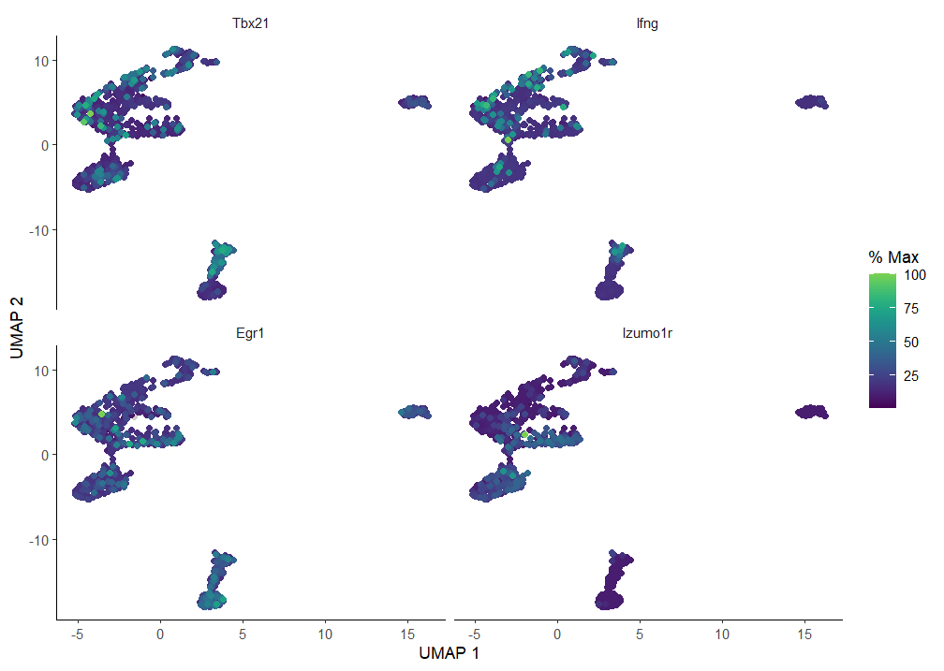
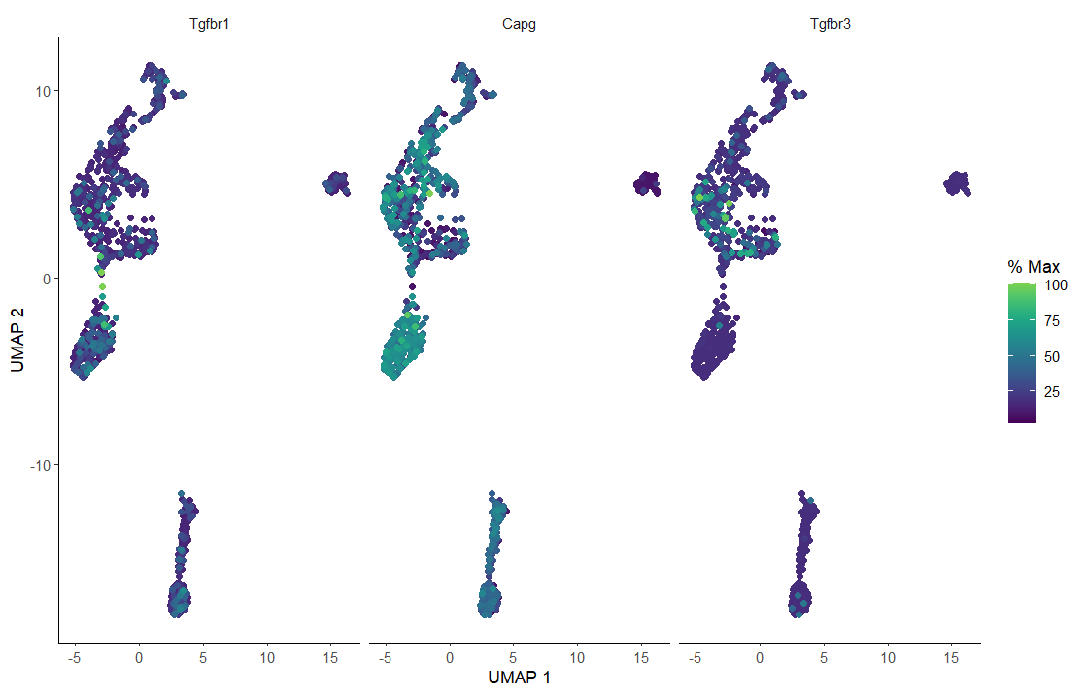
Gene expression in CUE

Slide 16
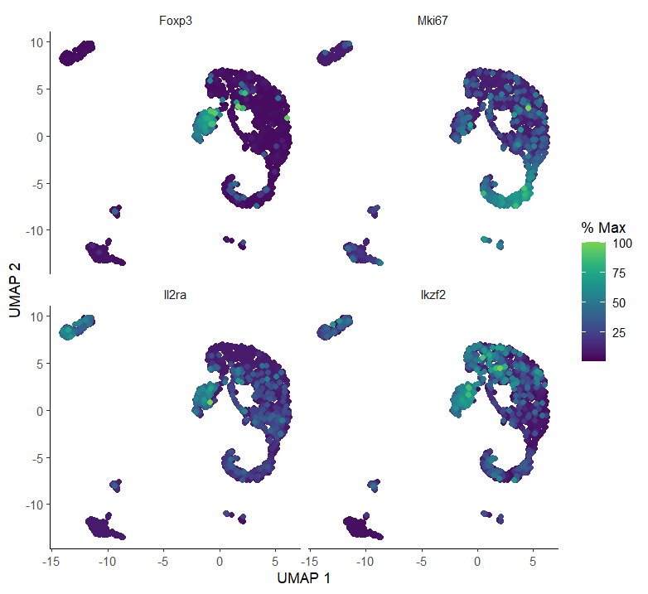
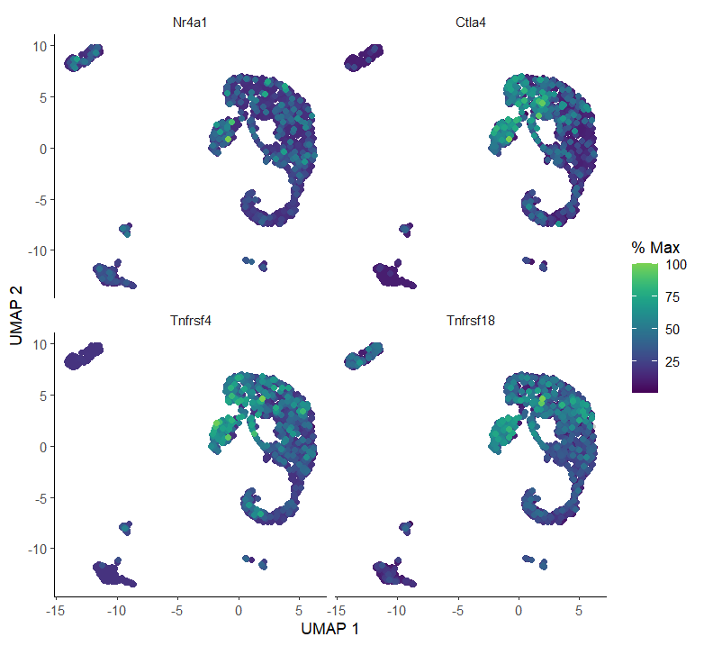
Gene expression in PBS

Slide 17
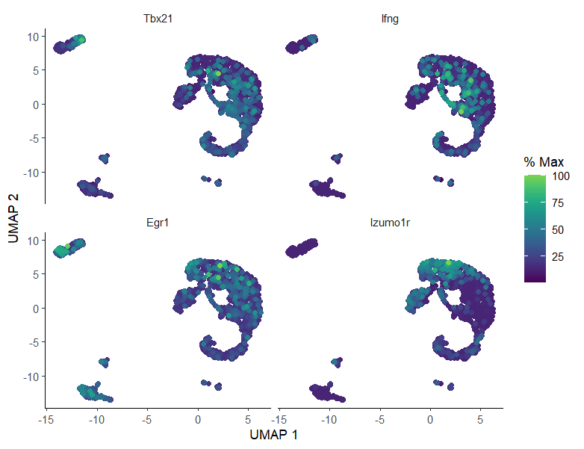
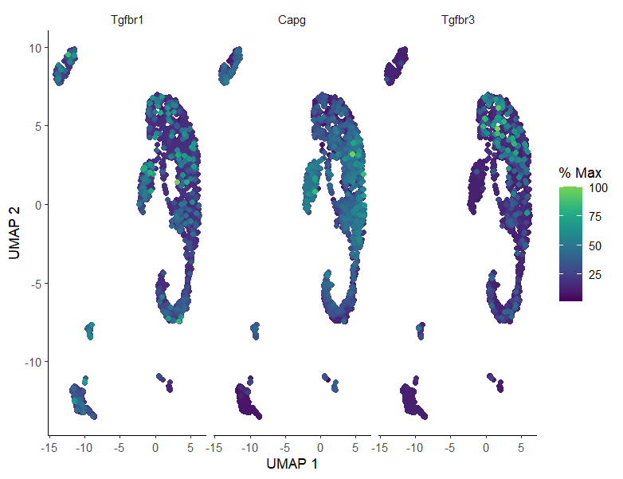
Gene expression in PBS

Slide 18
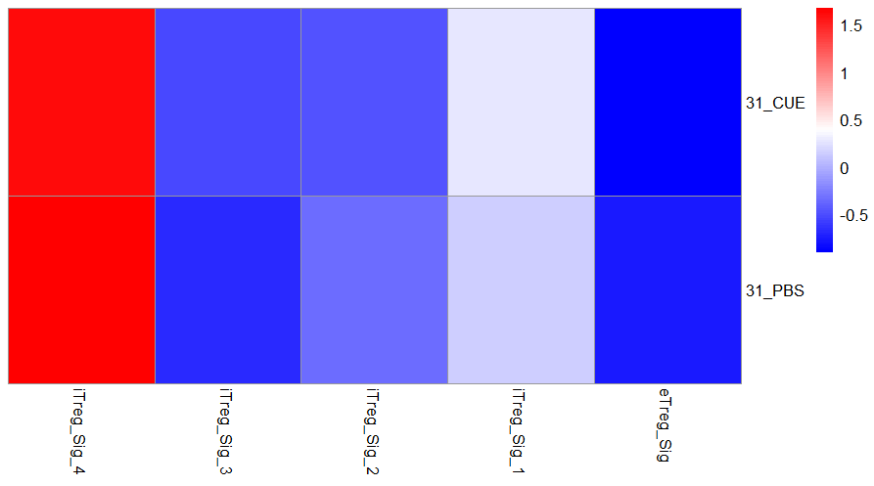
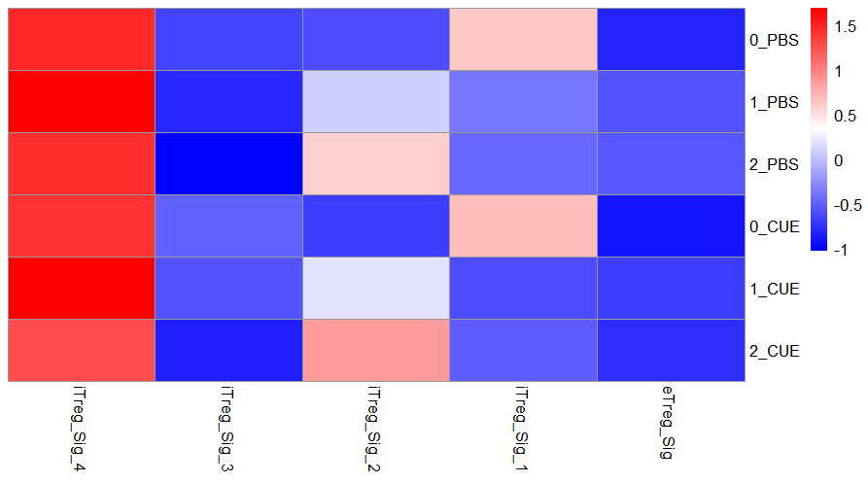
Heatmap of iTreg signatures

